Slide 1
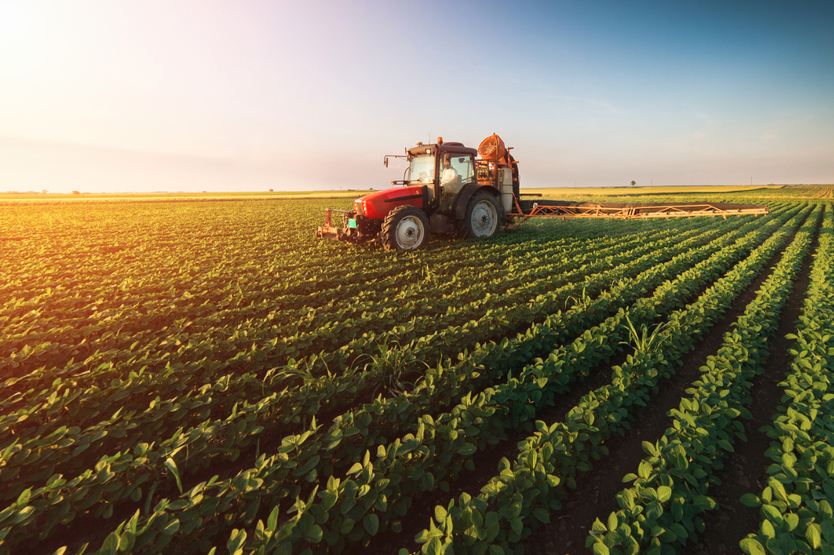
PROBLEM SOLVING USING ANALYTICAL AND DESIGN THINKING
Project Title: Building Trust in Smart Agriculture
Project Domain: Smart Agriculture
NAME:KAVIBHARATHI G

Slide 2
Problem Breakdown
Issue
1
2
Cause
Farmers do not trust the accuracy and reliability of the system outputs
Hesitation to rely on ML-based recommendations
Insufficient farmer training on system usage
Lack of transparency and explainability in ML predictions
Building Trust in Smart Agriculture
Technology
3
4
Impact
Smart agriculture systems using machine learning for crop and farming predictions.
Low adoption of smart agriculture solutions
Data-driven farming benefits remain unrealized
Reduced improvement in productivity and decision-making

Slide 3
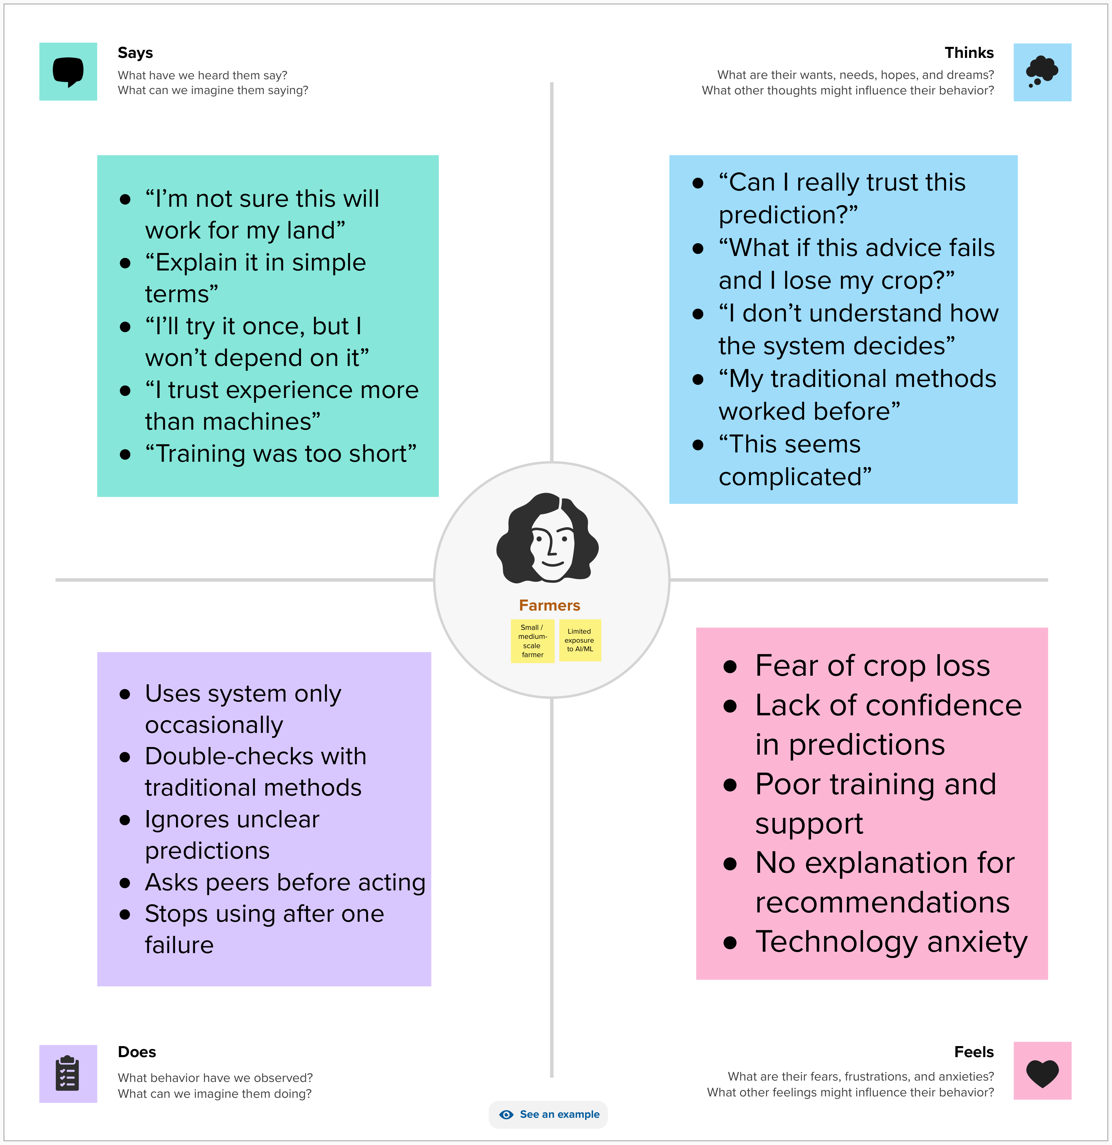
User Understanding
Empathy mapping
1. Says
“I don’t know if I can trust these predictions.”
“I need guidance in my own language.”
2. Thinks
“What if I make a wrong decision and lose my crops?”
“Is this technology really worth using?”
3. Does
Mostly relies on traditional farming methods
Occasionally checks digital tools but ignores recommendations
4. Feels
Confused and skeptical about ML outputs
Anxious about crop yield and financial loss

Slide 4


Target User Persona
Pain Points
Trust
Training
Technology
Farmers are skeptical of recommendations and cannot verify outputs
Limited guidance on using smart agriculture tools or interpreting results
Farmers prefer traditional methods due to fear of mistakes and unclear benefits
Name: Ramesh Kumar Occupation: Small to medium-scale farmer Location: Rural India Age: 55–60 years Tech Comfort: Basic smartphone usage, limited exposure to digital tools Goals: Improve crop yield, reduce losses, make informed farming decisions

Slide 5
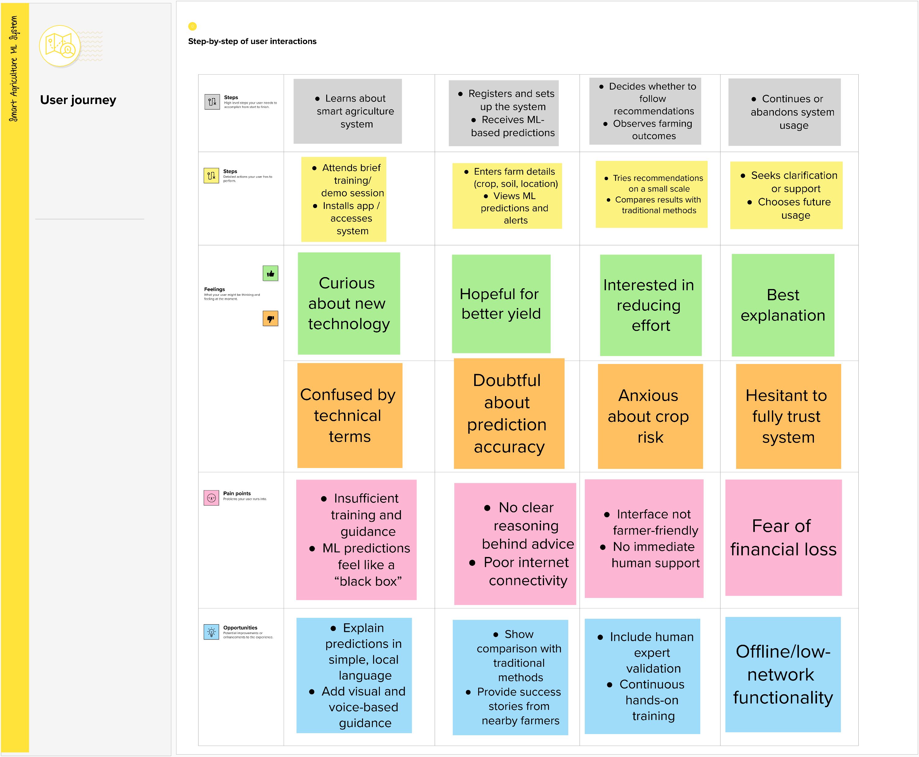
User Journey – Farmer Using Smart Agriculture System
1. Awareness
Farmer hears about the ML-based agriculture system
Initial curiosity but limited understanding
2. Onboarding & First Use
Tries the system with minimal training
Finds predictions difficult to interpret
3. Decision-Making
Hesitates to follow ML recommendations
Prefers traditional farming methods
4. Outcome
Uses the system inconsistently or stops using it
Low adoption leads to unrealized benefits

Slide 6

SWOT
STRENGTHS
WEAKNESSES
Builds farmer trust through explainable ML outputs
Local language and voice-based support
Data-driven decision support improves accuracy
Requires initial training and onboarding effort
Dependence on data quality and system availability
OPPORTUNITIES
THREATH
Growing adoption of digital tools in agriculture
Government support for smart farming initiatives
Scalability across crops and regions
Resistance to change from traditional practices
Low digital literacy in rural areas
Infrastructure limitations (internet, devices)

Slide 7
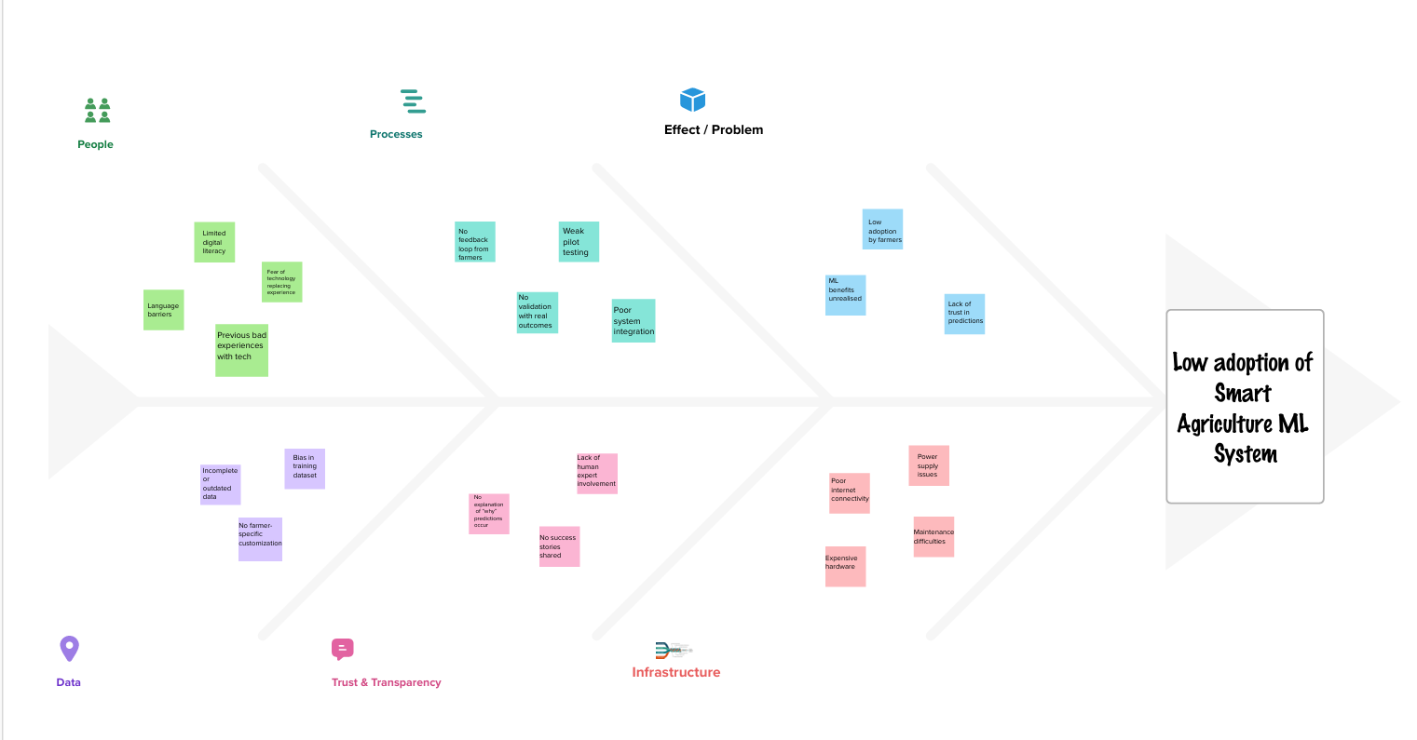
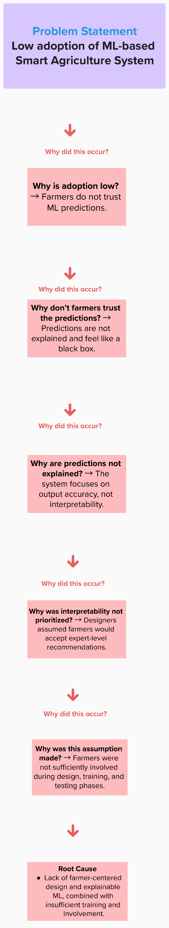
Problem Framing

Slide 8
Root Cause
Absence of a farmer-centric, explainable, and well-supported ML system
Lack of Explainability in ML Outputs Farmers cannot understand how predictions are generated, reducing trust.
Inadequate Training and Awareness Limited hands-on training prevents effective use of the system.
Low Digital Literacy Among Farmers Difficulty in navigating technology leads to hesitation.
Poor User-Centric System Design Interfaces are not tailored to farmers’ needs, language, or context.

Slide 9
Ideation and Solution Selection
Idea
Idea
Trust indicators showing confidence level of predictions.
Idea
Hands-on farmer training programs with demos
Idea
Voice-based guidance and local-language support
Interactive ML dashboard with simple visual explanations
⭐ Final Chosen Solution (Highlighted)
Farmer-Centric Explainable ML Platform with Local Language & Guided Training

Slide 10
Why This Solution Was Chosen
1
2
1
Impact
2
Affinity Logic
3
Directly addresses key pain points: trust, training, and usability
Aligns with farmer needs and real-world constraints
Builds trust by explaining why predictions are made
Improves farmer confidence and decision-making
Increases adoption of smart agriculture systems
3
Effort
Uses existing ML models with improved interface design
Moderate implementation effort with high usability gains

Slide 11
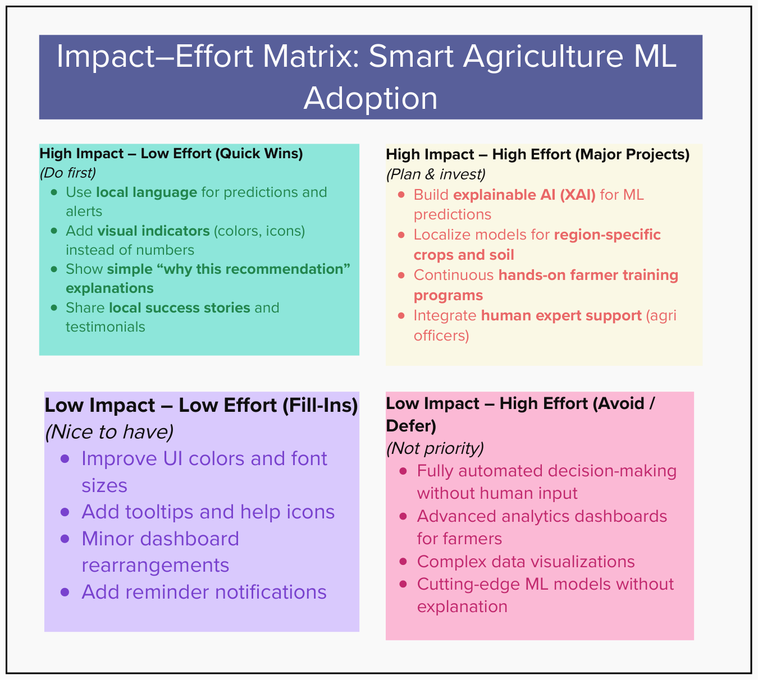
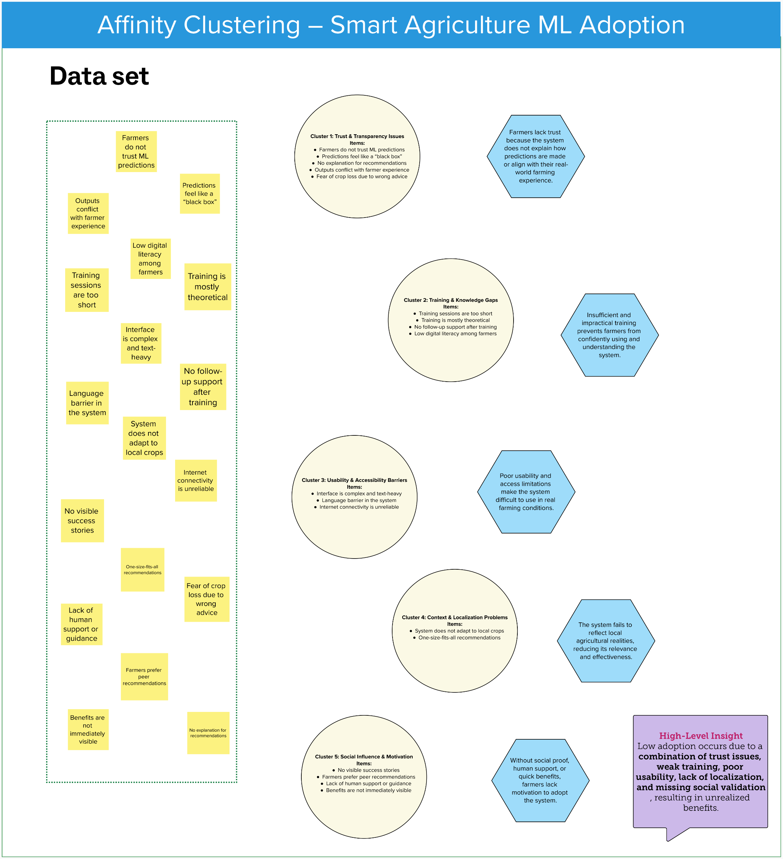

Slide 12
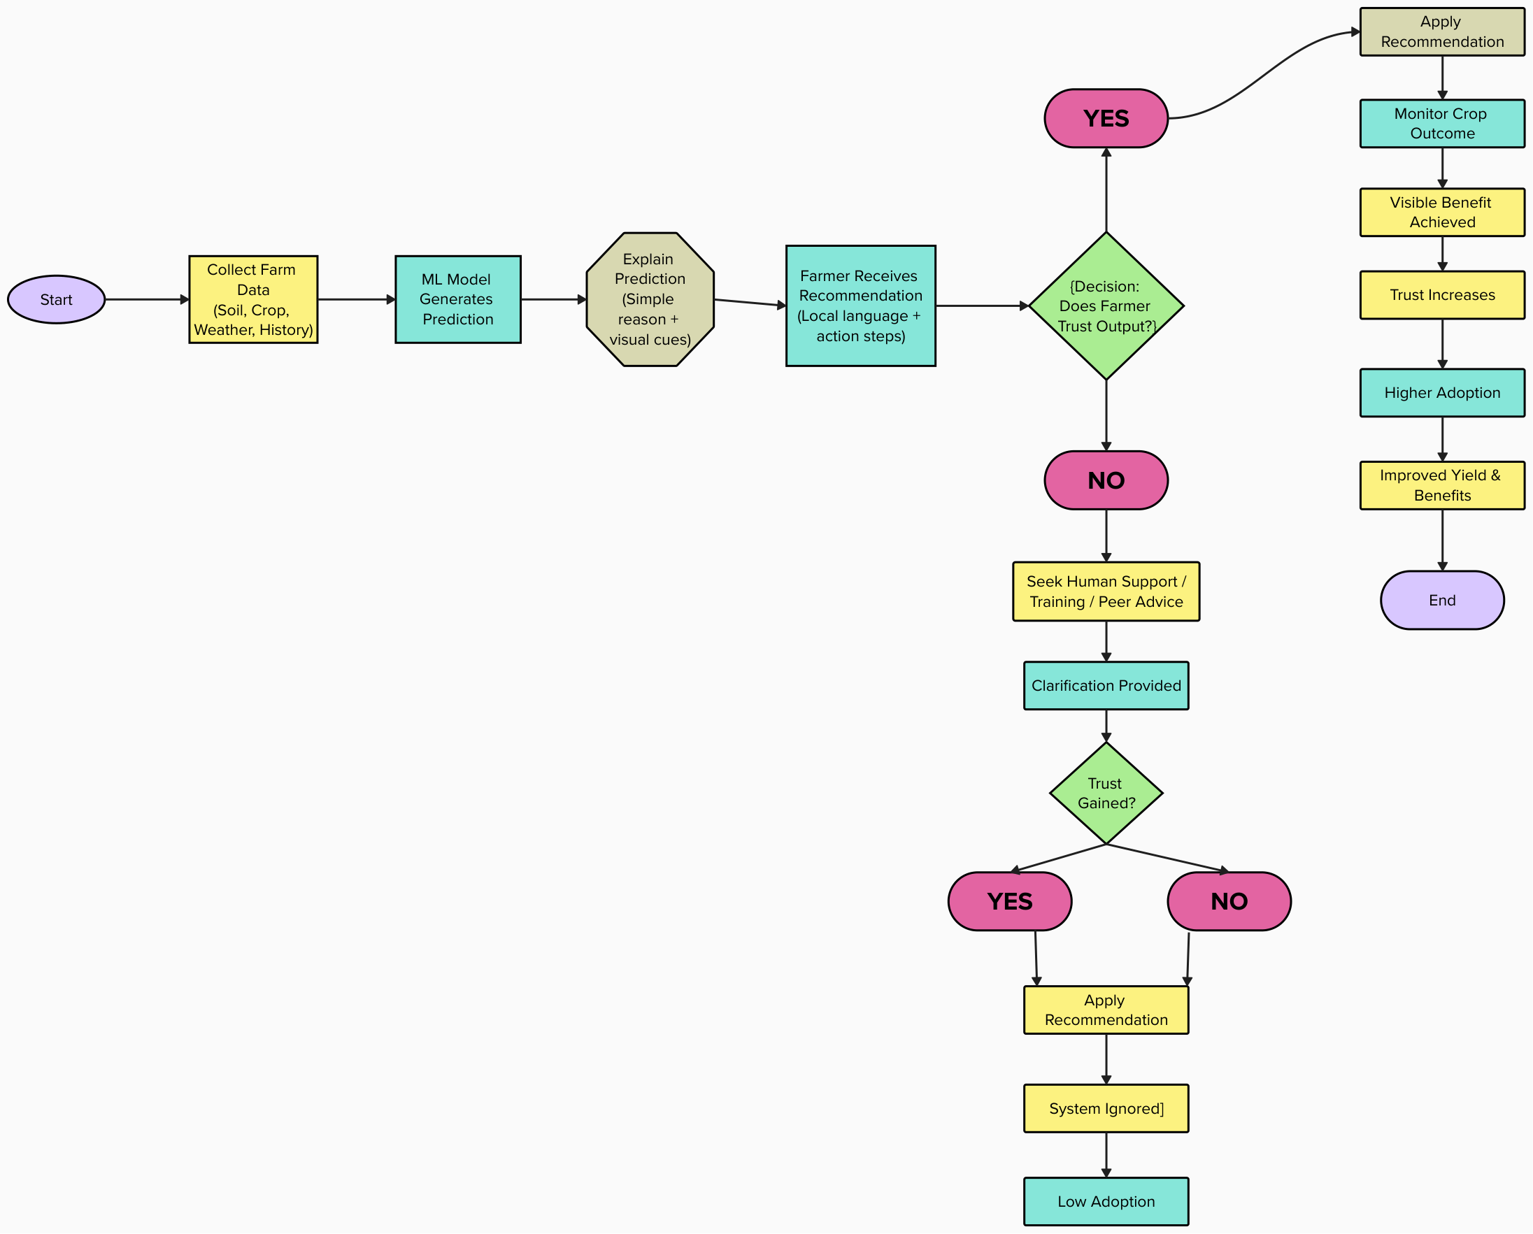
FLOW CHART

Slide 13
Key Features
Explainable ML Predictions Simple visuals and reasons behind each recommendation
Local Language & Voice Support Guidance in regional languages for easy understanding.
Confidence & Risk Indicators Shows prediction reliability and possible risks.
Guided Farmer Training Module Step-by-step onboarding with real-world examples
1
2
3
4

Slide 14
Feedback & Iteration
Before Feedback
After Feedback
ML predictions shown using technical terms
Predictions explained using simple visuals and icons
Text-heavy dashboard difficult to understand
Voice-based guidance added in local language
No clarity on why recommendations were given
Clear reasons and confidence levels shown for each recommendation
Limited guidance for first-time users
Step-by-step guided onboarding and training included

Slide 15


Testing Methods Used
Upstream & Downstream Environmental Aspects
Think-Aloud
Dot-Voting
Farmers marked features they found most useful
Identified least understood or confusing elements
Helped prioritize features for improvement
Enabled quick, collective decision-making
Farmers explained what they understood from each screen
Helped identify confusion in ML predictions and terminology
Revealed trust and hesitation during decision-making
Highlighted usability and navigation issues in real time

Slide 16
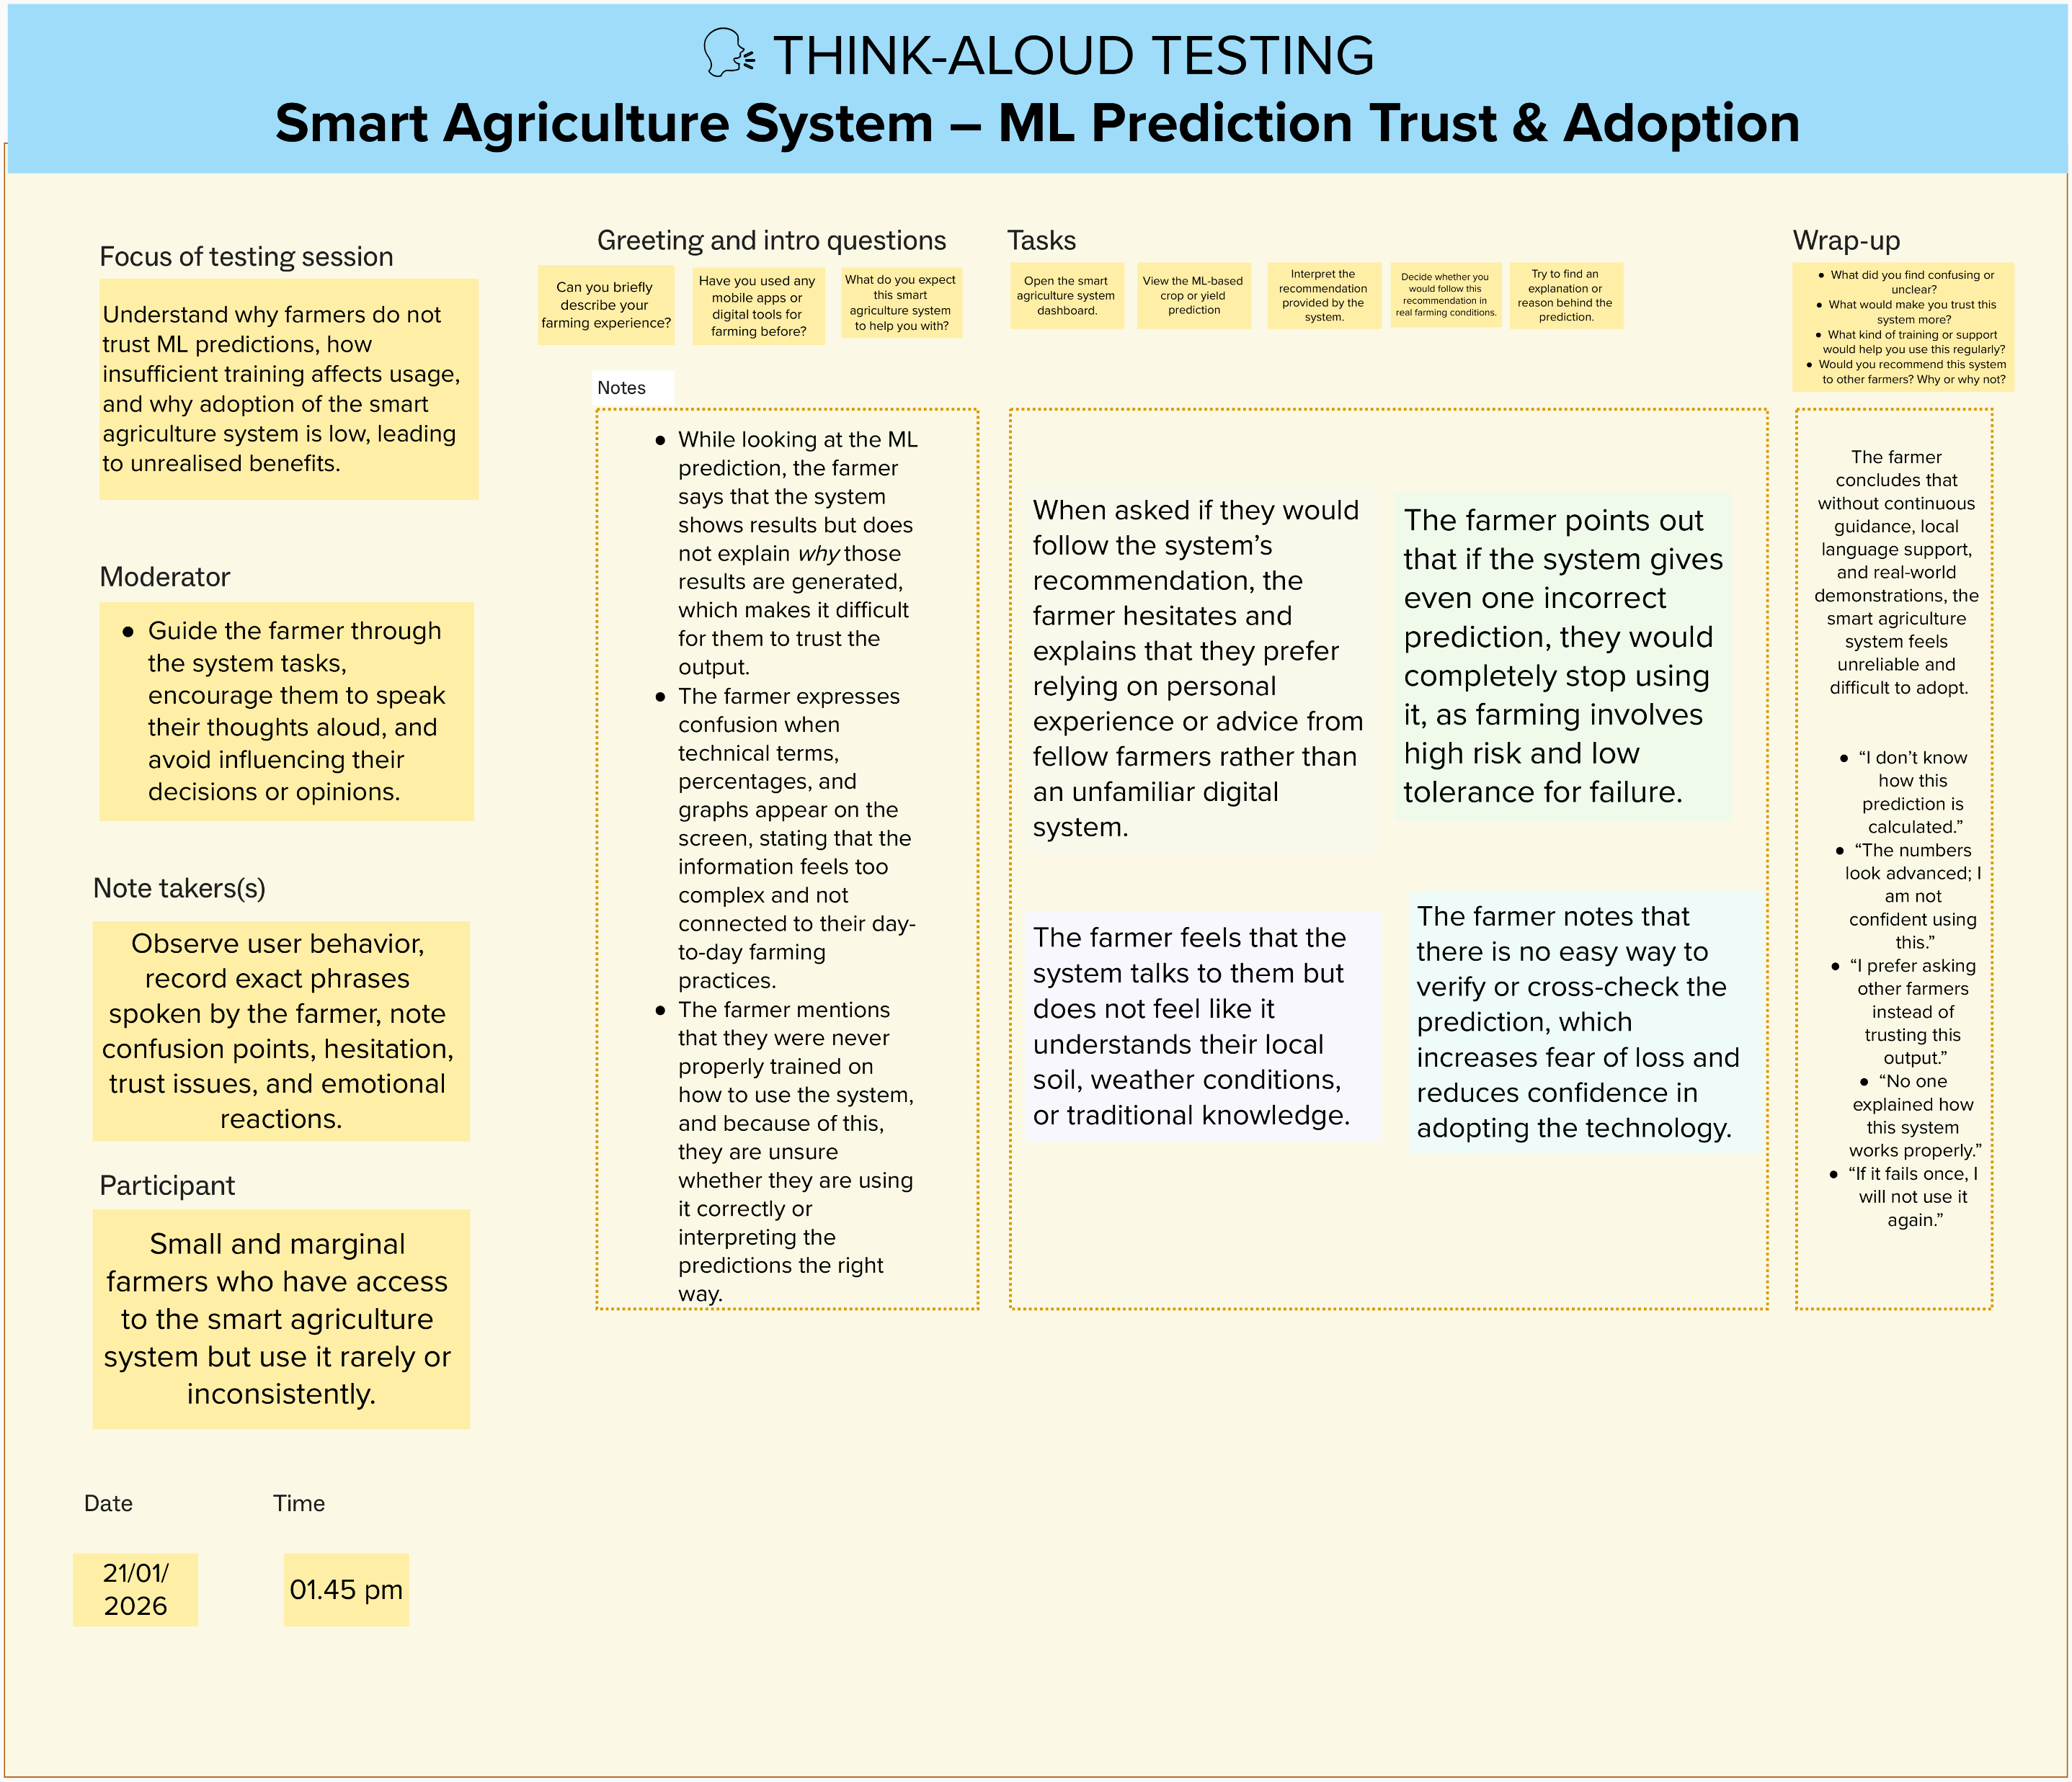
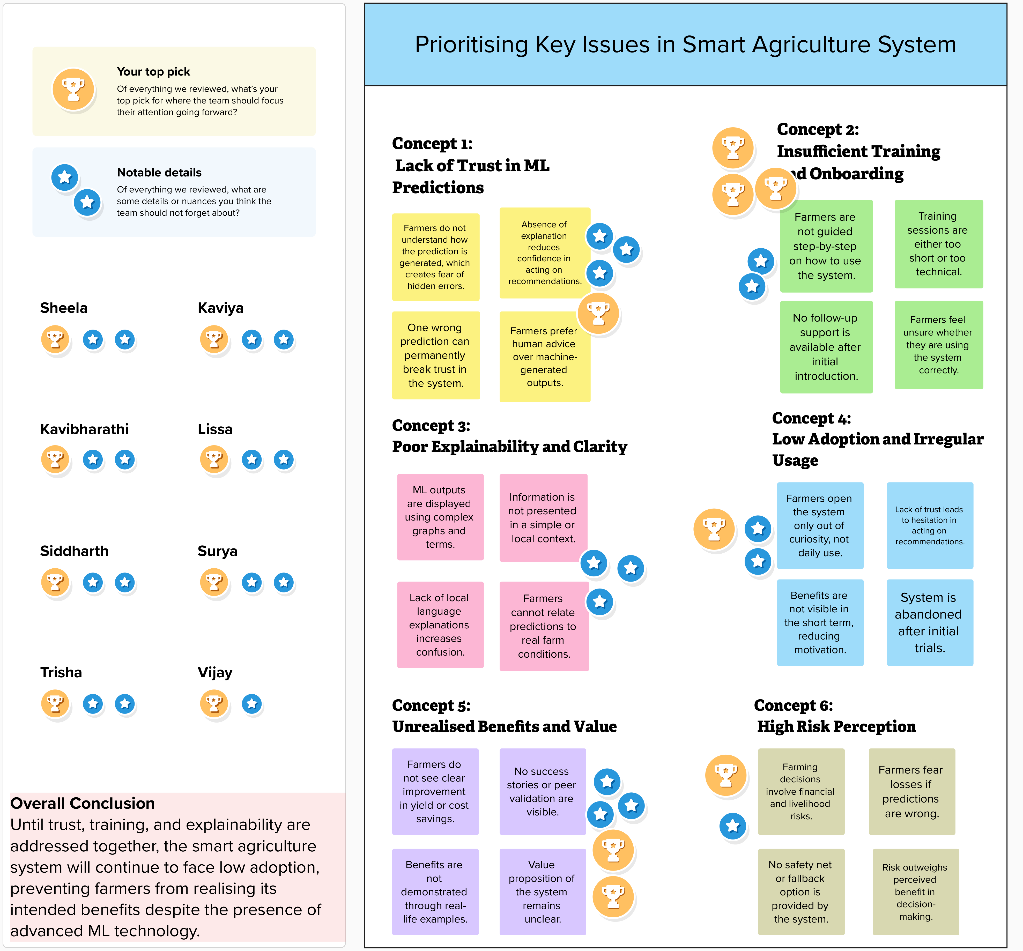

Slide 17


